Slide 1


Know Your Resources | Save These Numbers In Your Phone
Who | How To Reach Them
Life-threatening emergency | 911
UCPD (non-emergency) | 805-893-3446 · police.ucsb.edu
CAPS After-Hours Crisis Line (nights, weekends, holidays) | 805-893-4411 · caps.sa.ucsb.edu
CARE: confidential advocacy for survivors | 805-893-4613 · care.ucsb.edu
Worried about a friend? Student Mental Health Coordination Services (SMHCS) | 805-893-3030 · studentsindistress.sa.ucsb.edu · or refer online via the CARE Report portal
Notes:
Put these contacts in your phone today. Call 911 for anything life-threatening and UCPD for non-emergencies. The CAPS crisis line is there nights, weekends, and holidays. CARE offers confidential advocacy. If you're worried about a friend, SMHCS can connect them with a case manager.

Slide 2
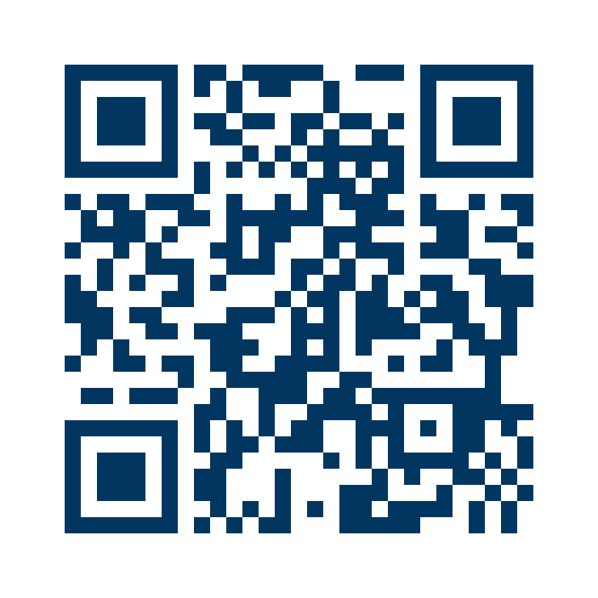
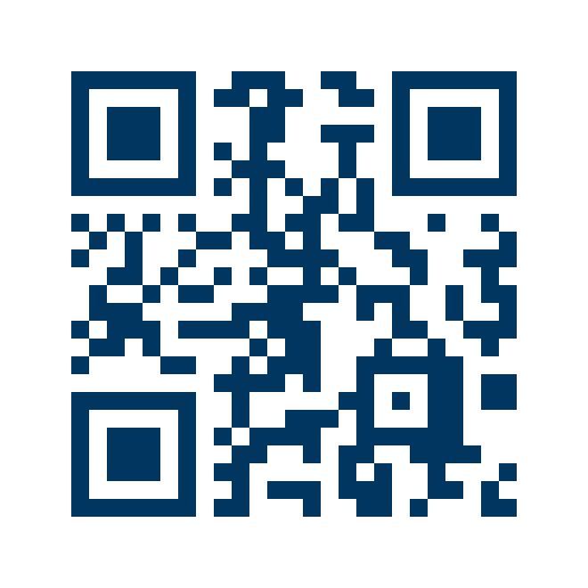
Know Your Resources | In A Crisis Or Emergency
Emergency: 911 Or UCPD
CAPS After-Hours Crisis Line
Call if you or someone else is in immediate danger.
Talk with someone right away, nights, weekends, and holidays.
Website
police.ucsb.edu
911 · 805-893-3446
Website
caps.sa.ucsb.edu
805-893-4411
Good to know: If someone is in immediate danger, call 911 or UCPD. Stay with them, if it's safe, until help arrives.
Notes:
If you or someone near you is in danger, call 911 or UCPD right away. After hours, the CAPS crisis line is available nights, weekends, and holidays.

Slide 3
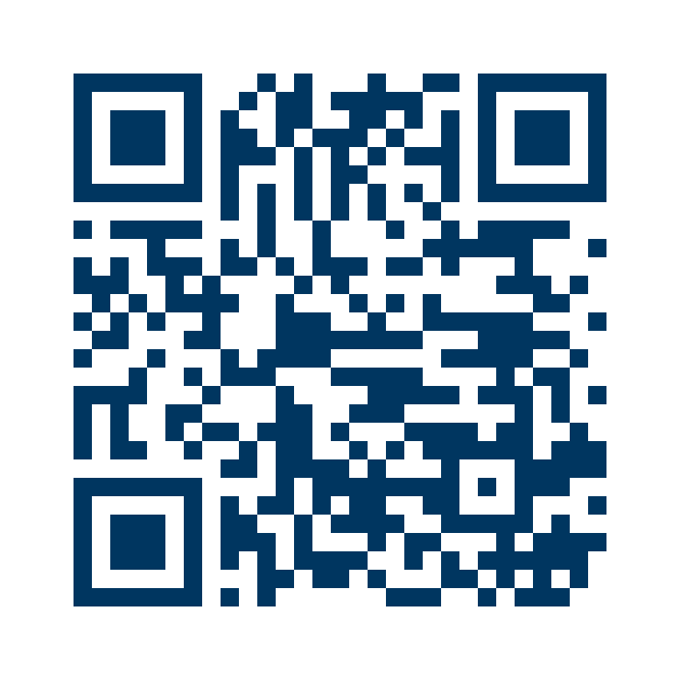
Know Your Resources | When You're Having A Hard Time
Counseling & Psychological Services (CAPS)
Student Mental Health Coordination Services (SMHCS)
Free, confidential counseling for enrolled students. You don't need a diagnosis to go.
Worried about a friend? Let SMHCS know, and a case manager will reach out to support them.
Website
caps.sa.ucsb.edu
Website
studentsindistress.sa.ucsb.edu
805-893-3030
Good to know: Not sure what you're feeling, or whether it “counts”? You can still go to CAPS to talk and get more information.
Notes:
CAPS offers free, confidential counseling, and you don't need a diagnosis or certainty about what you're feeling to go. If you're worried about a friend, SMHCS connects them with a case manager.

Slide 4
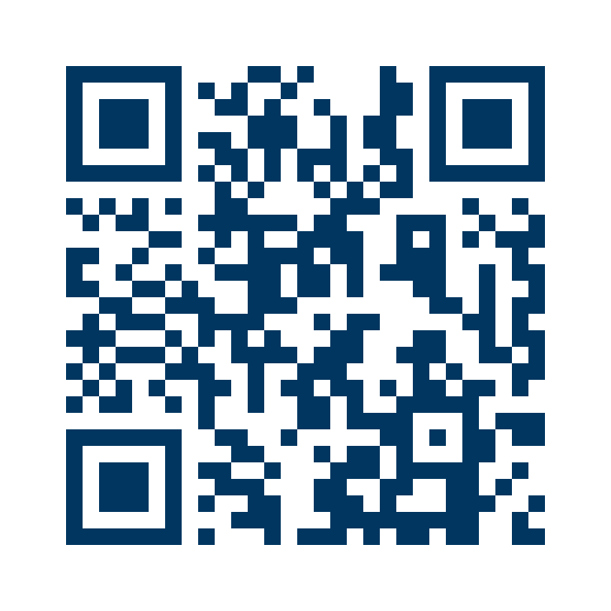
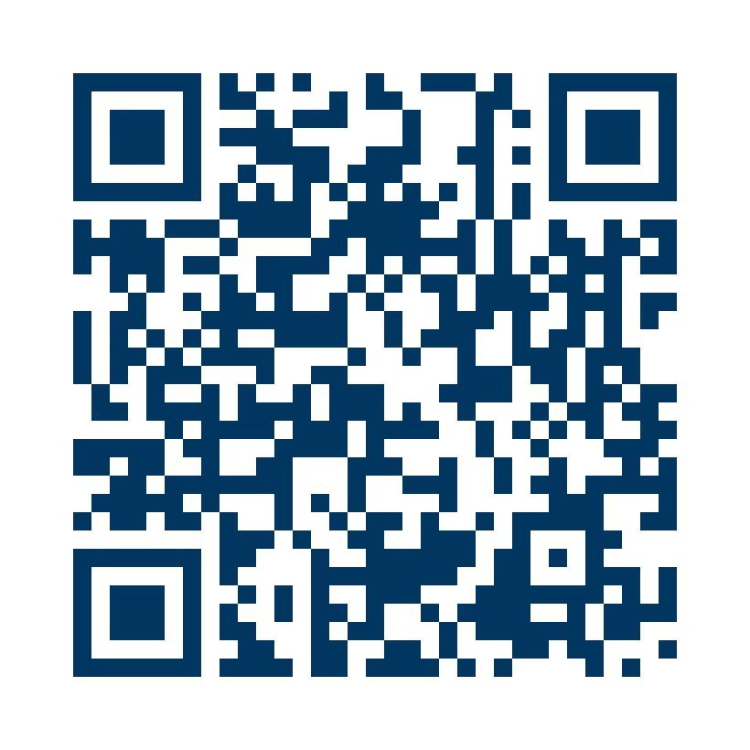
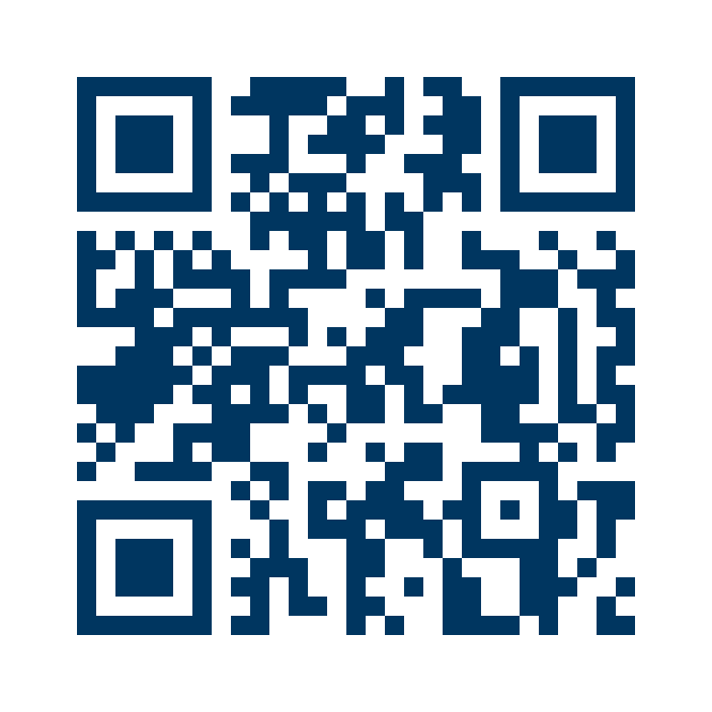
Know Your Resources | Food, Housing & Money
Basic Needs Program
AS Food Bank & Miramar Food Pantry
Your central hub for food, housing, and financial security resources.
Free groceries, no questions asked.
Website
basicneeds.ucsb.edu
foodbank.as.ucsb.edu
dining.ucsb.edu/
miramar-food-pantry
Good to know: You don't need documentation or proof to get food and other everyday essentials.
Notes:
If food, housing, or money is tight, start with the Basic Needs Program. The AS Food Bank and Miramar Food Pantry offer free groceries with no documentation needed.

Slide 5
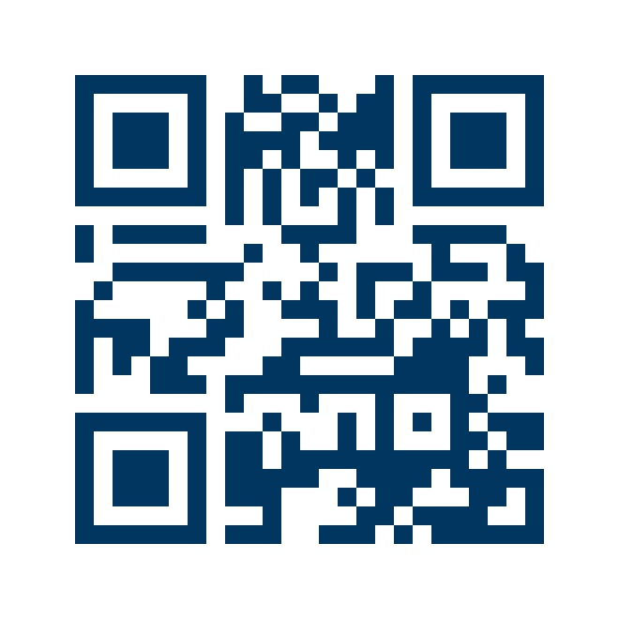
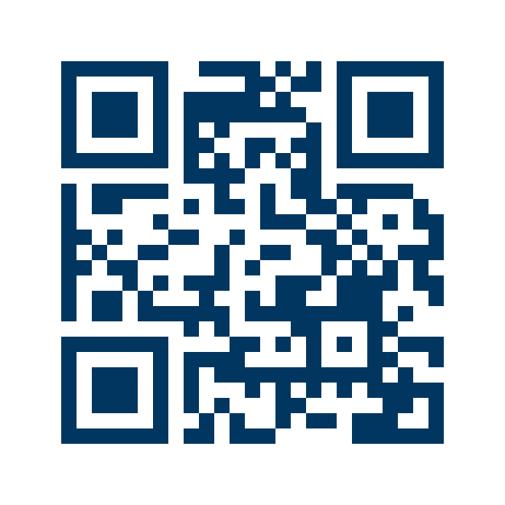
Know Your Resources | Help With Classes & Accommodations
Campus Learning Assistance Services (CLAS)
Disabled Students Program (DSP)
Free tutoring, study groups, and academic coaching.
Accommodations for students with documented disabilities.
Website
clas.sa.ucsb.edu
Website
dsp.sa.ucsb.edu
Good to know: Asking for academic help is a normal part of college, not a sign that you're falling behind.
Notes:
CLAS offers free tutoring, study groups, and coaching. DSP works with students who have documented disabilities to set up accommodations.

Slide 6
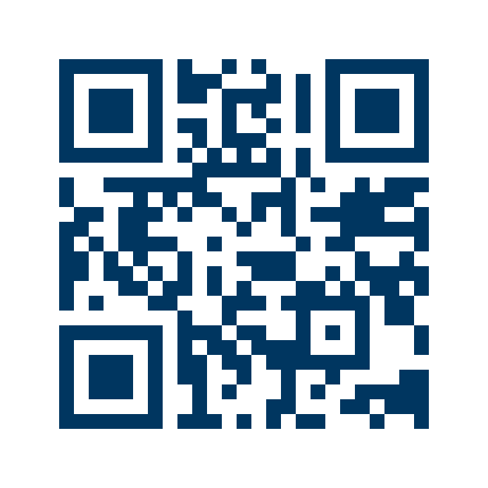
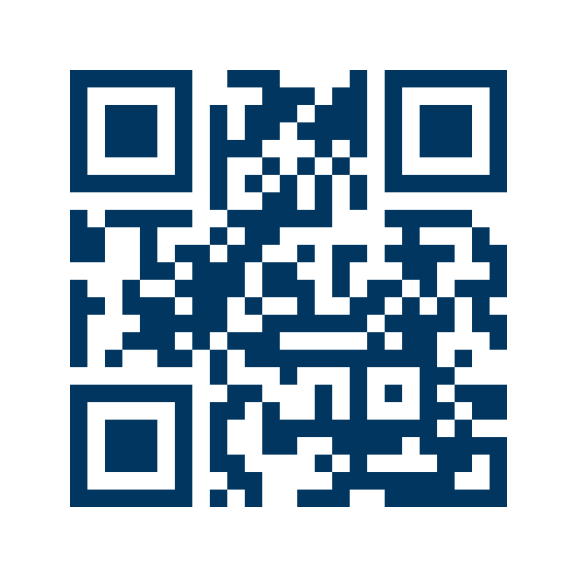
Know Your Resources | Finding Your Community
MultiCultural Center
Office Of Black Student Development
Programming and community space for multicultural student life.
Advising, programming, and community support, open to all students.
Website
mcc.sa.ucsb.edu
Website
obsd.sa.ucsb.edu
Good to know: These spaces are for you. Stop by, check out an event, and meet people along the way.
Notes:
The MultiCultural Center and the Office of Black Student Development offer programming, community, and support. Drop in or check out an event.

Slide 7
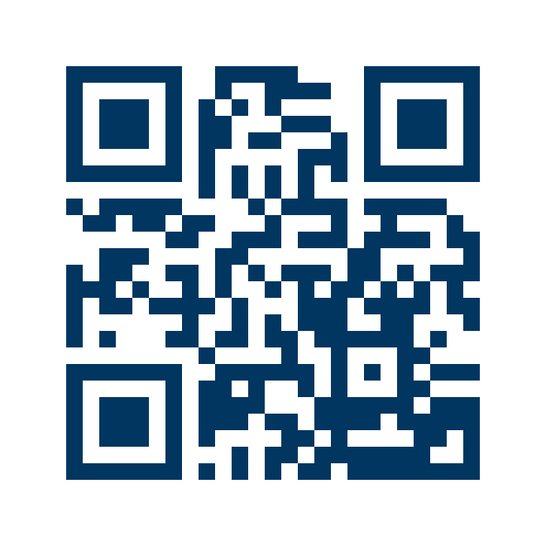
Know Your Resources | If You've Experienced Harm
CARE (Campus Advocacy, Resources & Education)
Confidential advocacy for survivors of sexual assault, dating/domestic violence, and stalking.
Website
care.ucsb.edu
805-893-4613
Good to know: Most university staff, including faculty, are required to report what you share with them. CARE is confidential, so you can talk there first.
Notes:
CARE provides confidential advocacy for survivors of sexual assault, dating or domestic violence, and stalking. Because most staff are required to report, CARE is the place to start if you want to talk confidentially.

Slide 8
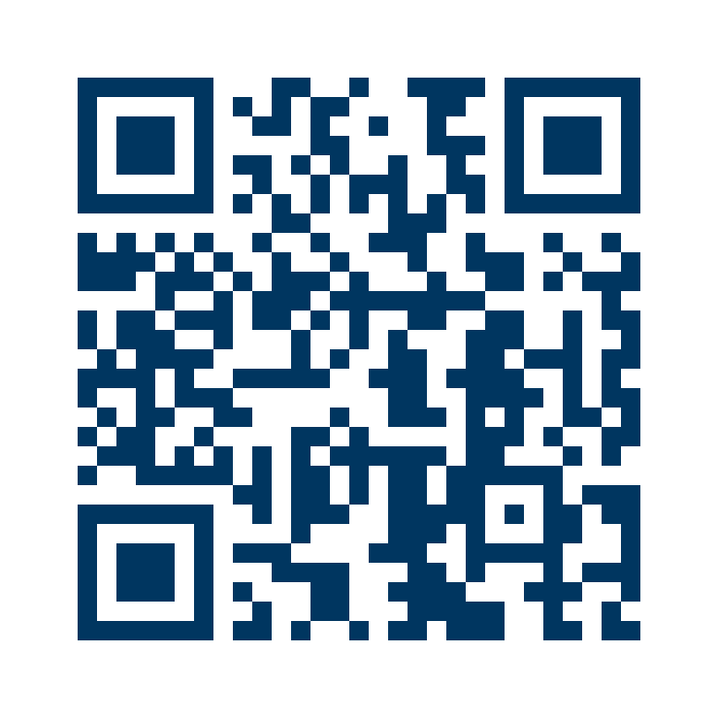
Know Your Resources | Student Conduct & Your Rights
Office Of Student Conduct
Oversees the Student Conduct Code and reviews reports when a student may have violated it. You can also report misconduct to the office.
If you're part of a conduct case, you can bring an advisor to every step, share your side and present information, and appeal a decision.
Depending on the case, resolution can include restorative justice or an educational agreement.
Website
studentconduct.sa.ucsb.edu
805-893-5016
Good to know: You don't have to go through the conduct process alone. An advisor can help you prepare and can join your meetings.
Notes:
The Office of Student Conduct oversees the Student Conduct Code. Students involved in a case have the right to an advisor, to present information, and to appeal. Some cases can be resolved through restorative justice or an educational agreement.

Slide 9
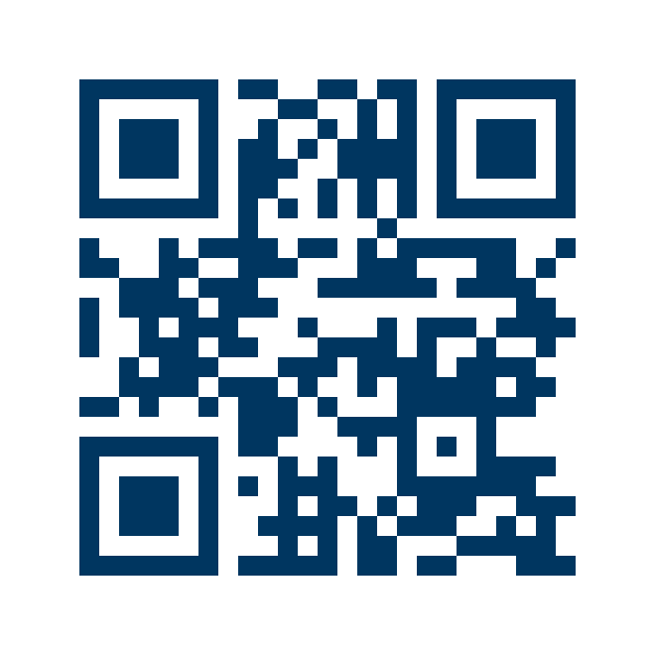
Know Your Resources | Planning Your Career
Career Services
Advising, internships, employer connections, and career-readiness programming.
Get a professional headshot for LinkedIn or applications in the Iris Photo Booth, a self-service, drop-in booth in the Career Resource Room.
Need something to wear to an interview? Borrow an outfit from the professional clothing closet.
Website
career.ucsb.edu
Good to know: Ask a professor to point you to Career Services. A faculty referral carries real weight in the professional world.
Notes:
Career Services helps with advising, internships, employer connections, and career readiness. Students can drop in for a professional headshot in the Iris Photo Booth and borrow interview clothes from the clothing closet. A referral from a professor can open doors.

Slide 10
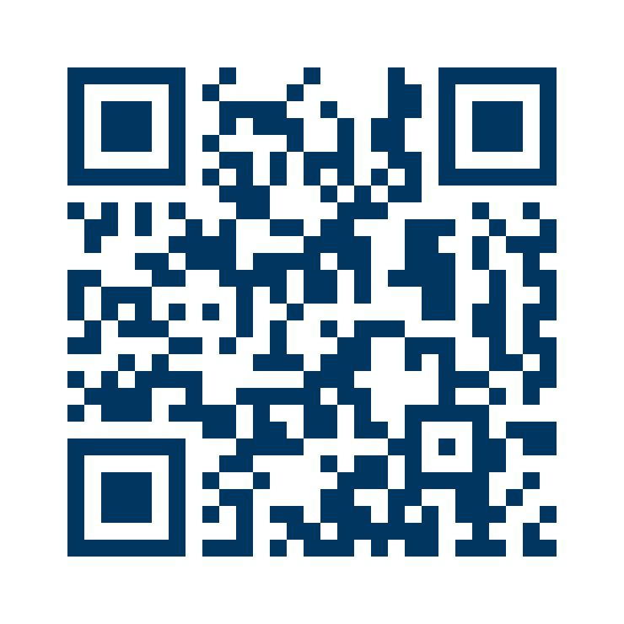
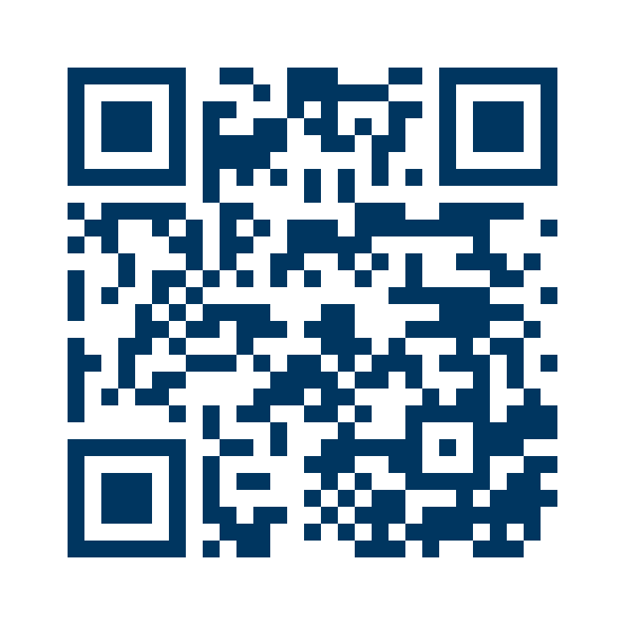
Know Your Resources | Staying Well
Health & Wellness
Student Health Service
Programs on sleep, stress, addictive behaviors & recovery, and healthy relationships.
Medical care, including same-day appointments.
Website
wellness.sa.ucsb.edu
Website
studenthealth.sa.ucsb.edu
Good to know: Wellbeing events happen all year. Making time for them can help you manage the fast pace of the quarter.
Notes:
Health & Wellness runs programs on sleep, stress, addictive behaviors and recovery, and relationships. Student Health Service provides medical care, including same-day appointments.

Slide 11

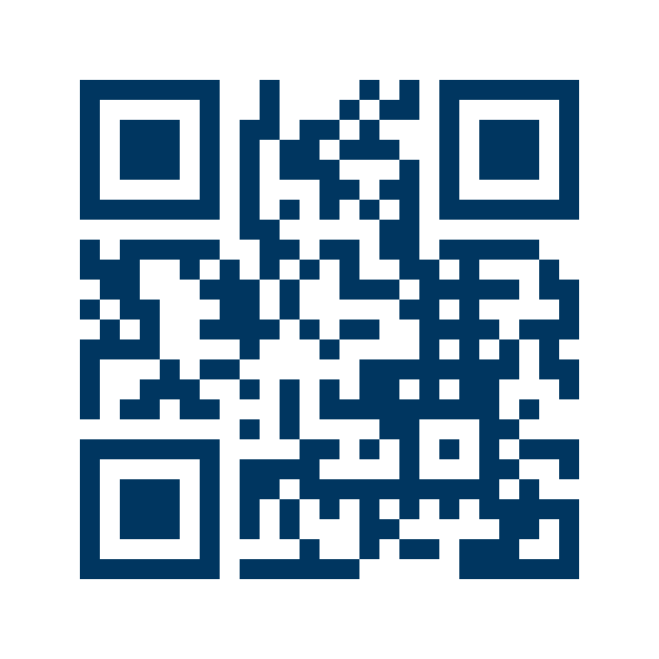
You Don't Have To Figure It Out Alone
Explore all Student Affairs services
sa.ucsb.edu
Notes:
Whatever you're facing, there's a place on campus to start. Scan the code or visit sa.ucsb.edu to see every Student Affairs department and service.

